Slide 1
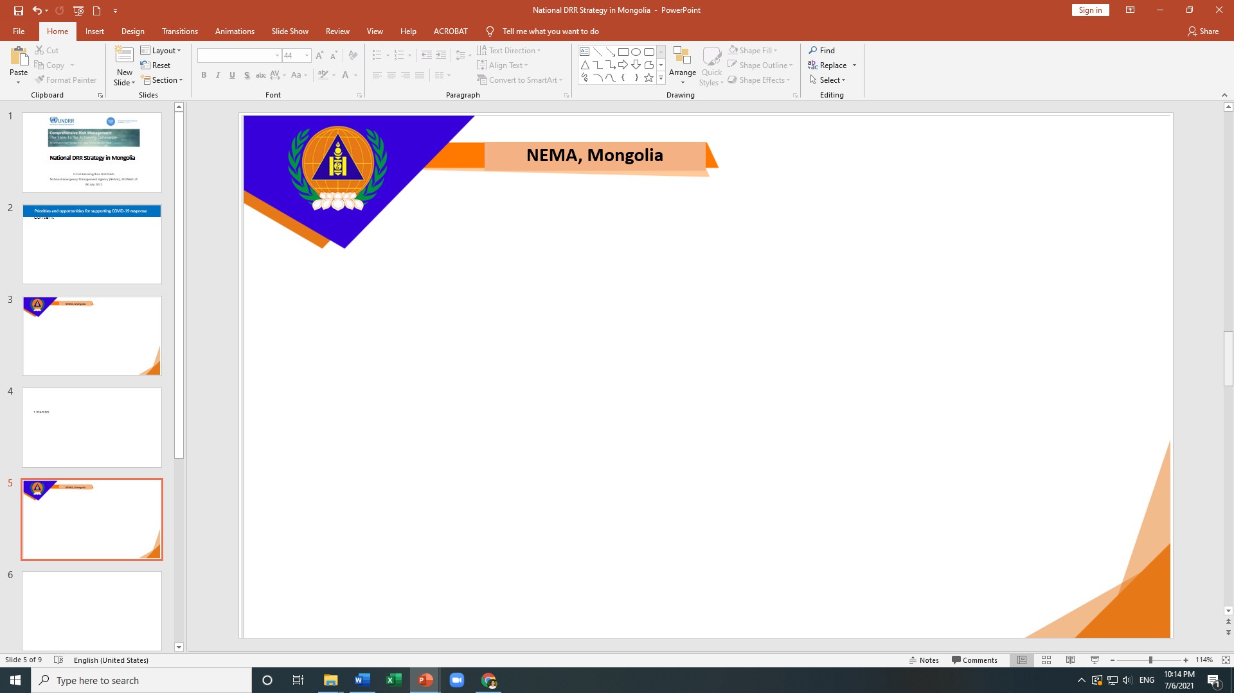
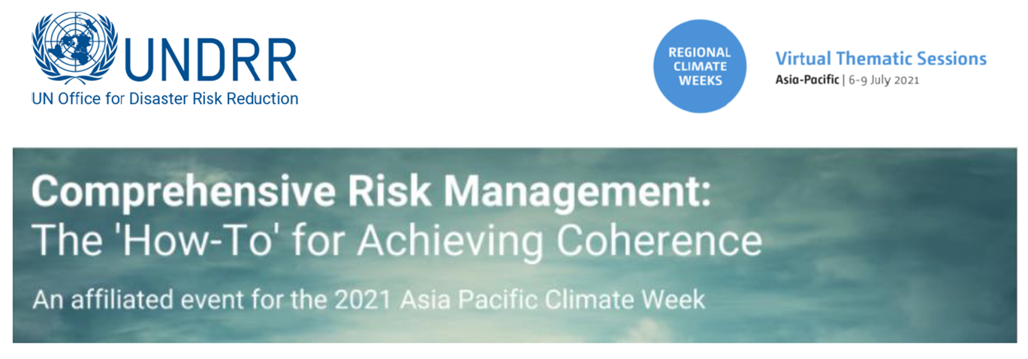
National DRR Strategy in Mongolia
Lt.Col Bazarragchaa DUUDGAI
National Emergency Management Agency (NEMA), MONGOLIA
08 July 2021

Slide 2
National Medium-term Strategy for the Implementation of Sendai Framework in Mongolia 2017-2030
Implementation phases
  phase 1: 2017-2020
    Action Plan by DPM, 2018, Order # 23
    Completed
  phase 2: 2021-2025
    Action Plan by DPM, 2021, Order # 51
    Ongoing
  phase 3: 2026-2030
    Action Plan will be developed in 2024-2025
    Implementing parties
  Lead organization: NEMA at national level, Local government & LEMA at local level
  Support parties: Relevant govt agencies & other stakeholders
Monitor & Evaluation
  Achievements of its objectives and activities
  Progress Report - every 2 years
Established by a working group with various members
  Identified issues based on baseline assessments
  Developed a draft strategy
Discussion with multi-stakeholders
  NEMA staff
  Government agencies (national and local), NGOs, private entities, academy and institutes, international organizations
  Public (web-based)
Approval
  National Strategy by the Government of Mongolia (resolution # 355, 2017)
  Action Plans by Deputy Prime Minister (DPM)

Slide 3
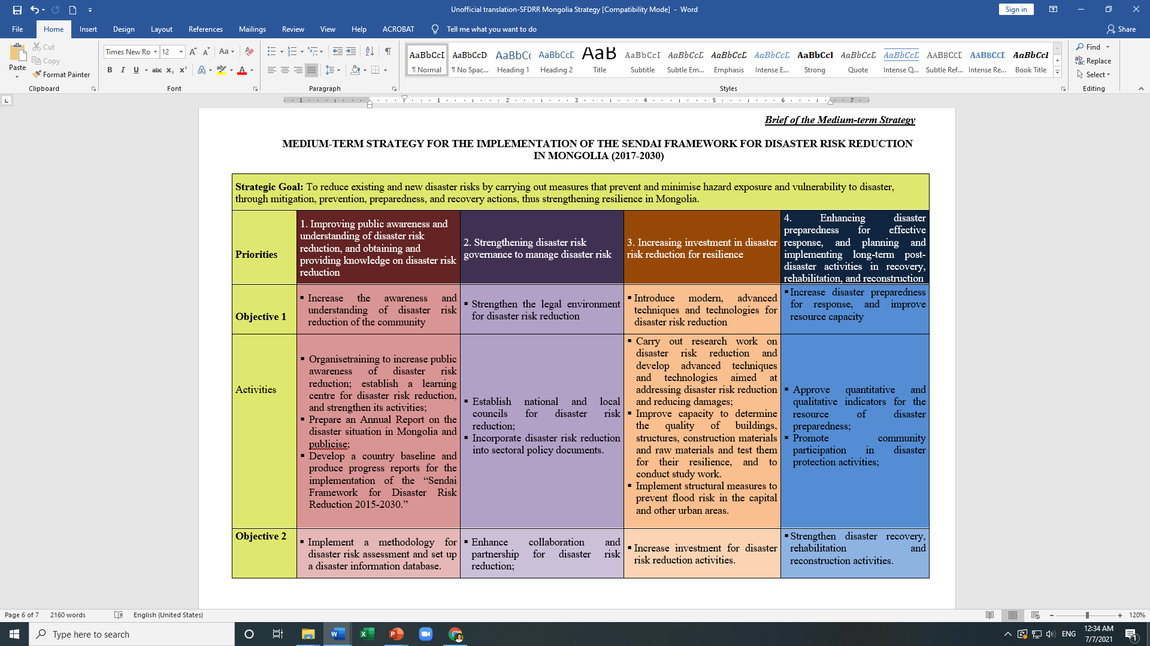

Slide 4
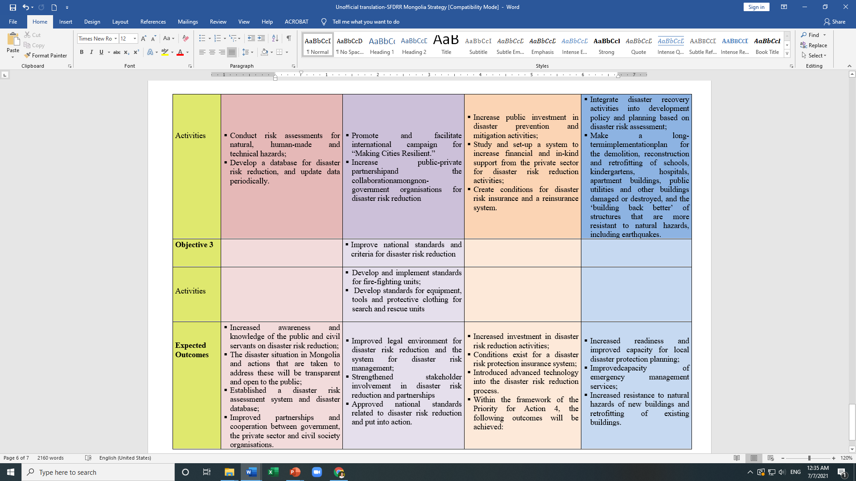

Slide 5
  Phase 2: Action Plan of National Medium-term Strategy for the Implementation of Sendai Framework in Mongolia (2021-2025)
The number of actions to be implemented between 2021-2025
Action Plan (Phase 2): |  | Priority 1 |  | Priority 2 |  |  | Priority 3 |  | Priority 4
 |  | Objectives |  | Objectives |  |  | Objectives |  | Objectives
 |  | 1 | 2 | 1 | 2 | 3 | 1 | 2 | 1 | 2
The number of actions | by each objective | 9 | 7 | 3 | 3 | 2 | 6 | 3 | 18 | 5
 | by each priority | 16 |  | 8 |  |  | 9 |  | 23
 | Total | 56
Notes: All objectives of DRR strategy & Action Plan (Phase 2) are directly and contentually linked with the current active national policies and their action plans on CCA
The number of actions: 56
Inclusion: child, PwD, gender
Integration: Climate change adaptation, SDG and national development strategies
Implementers: multi - lead & support stakeholders

Slide 6

Action Plan (Phase 2)
Highlights: Some actions leaded by the Ministry of Environment & Tourism
(1.2.1) Conduct disaster risk assessments by possible disaster types (initial assessments with other cross-sectoral team, detailed risk assessments by legal entities that received the disaster risk assessment special license)
(1.2.5) Study the impacts climate change on food and agricultural sector, develop potential risk map (with MOFA)
(1.2.6) Develop disaster data information system through providing some data related to weather and climate related hazards
(3.1.6) Establish Doppler weather radars to prevent flood risk in urban areas
(4.1.8) Ensure the readiness of disaster protection designated team and recourses; organize inspections for disaster preparedness (with NEMA)
(4.1.11) Improve pasture management, early warning of mountain and flash floods, drought and dzud and take early actions in order to adapt climate change
(4.2.3) Increase capacity to conduct post-disaster damage and needs assessments /develop guidelines for weather related disasters and prepare assessment team/
The Ministry of Environment & Tourism is one of the State Disaster Protection Services according to the Law on Disaster Protection (2017)

Slide 7
Lead implementers & the number of their responsible actions between 2021-2025
Action Plan (Phase 2) | Priority 1 |  | Priority 2 |  |  | Priority 3 |  | Priority 4 |  | Total
 | Objectives |  | Objectives |  |  | Objectives |  | Objectives
 | 1 | 2 | 1 | 2 | 3 | 1 | 2 | 1 | 2 | 9
Ministry of Education & Science | 2 | 1 |  |  |  |  |  |  |  | 3
Ministry of Health | 1 | 2 |  |  |  |  | 1 | 2 | 1 | 7
Ministry of Environment & Tourism |  | 3 |  |  |  | 1 |  | 2 | 1 | 7
Ministry of Labour and Social Protection | 1 | 1 |  |  | 1 |  |  | 2 | 1 | 6
Ministry of Energy |  | 2 |  |  |  |  |  | 2 | 1 | 5
Ministry of food, Agriculture and Light Industry |  | 3 |  |  |  |  |  | 4 | 1 | 8
Ministry of Road and Transportation Dev |  | 1 |  |  |  | 1 |  | 1 | 1 | 4
Ministry of Construction and Urban Dev |  | 3 | 1 |  |  | 2 |  | 2 | 2 | 10
Ministry of Finance |  |  | 1 |  |  |  | 1 | 2 |  | 4
Ministry of Culture |  |  | 1 |  |  |  |  |  |  | 1
Ministry of Defence |  |  |  |  |  |  |  | 1 |  | 1
Specialized Inspection Agency |  | 2 |  |  |  |  |  | 2 | 2 | 6
Standardization and Metrology Agency |  |  |  |  | 1 |  |  |  |  | 1
Communication & Information Technology Authority |  | 1 |  |  |  |  |  | 3 |  | 4
NEMA | 5 | 1 | 3 | 2 | 2 | 2 | 1 | 14 | 3 | 33
Local Governments | 1 | 1 | 1 | 1 |  | 1 | 1 | 4 |  | 10
Notes: *some actions shall be co-implemented by two or more stakeholders

Slide 8
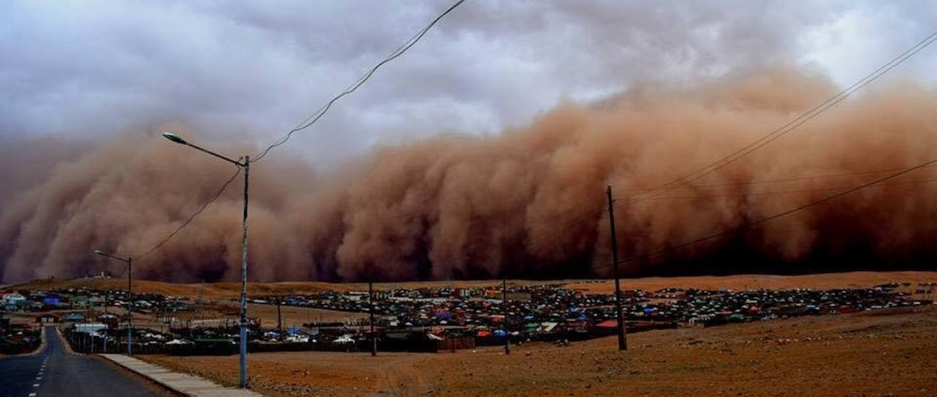
  Climate related disasters in Mongolia
In Mongolia
Increase of annual mean air temperature by 2.25 °C for the last 80 years (NAP, 2020)
Increase of occurrences and frequencies of climate related disaster hazards
Common types of climate related disasters
  Strong storms (snow and dust)
  Flood (mountain, river and flash)
  Wild fires (forest and steppe)
  Cold wave, Dzud (a severe winter)
  Drought

Slide 9
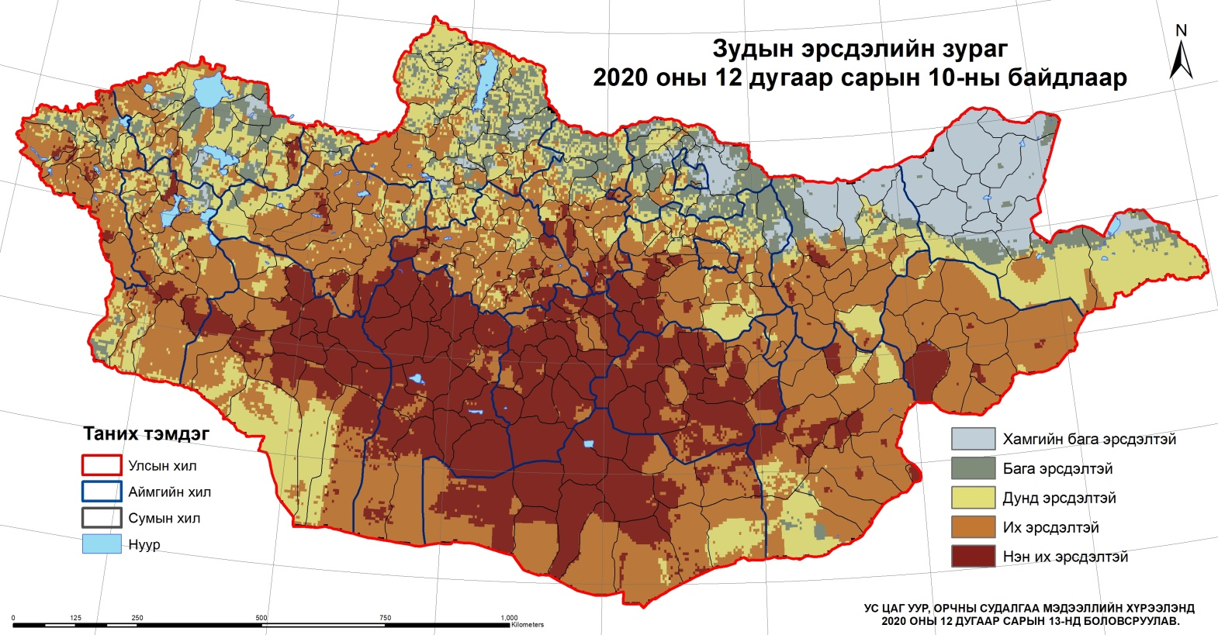
  Climate related disasters in Mongolia
In Mongolia
Risk informed plans
  Rapid Risk Assessments by cross-sectoral working group /almost every year/
    Dzud
    Drought
  Initial Disaster Risk Assessments at local level
    Flood, dzud, drought, forest and steppe fires, strong storms
  Initial flood risk assessments for road and railway
  Disaster resilience scorecard for cities (capacity assessment) MCR
Hazard mapping
Dzud hazard mapping, 10 Dec 2020
Resource: Meteorological Agency

Slide 10
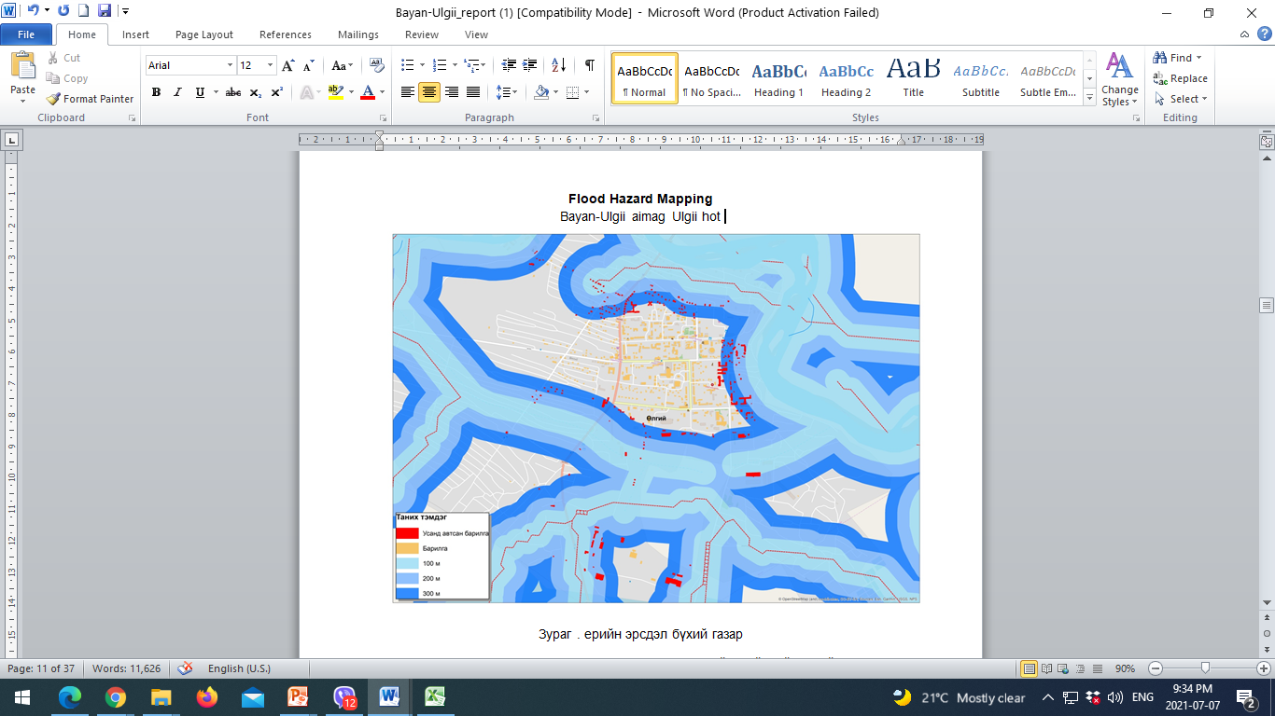
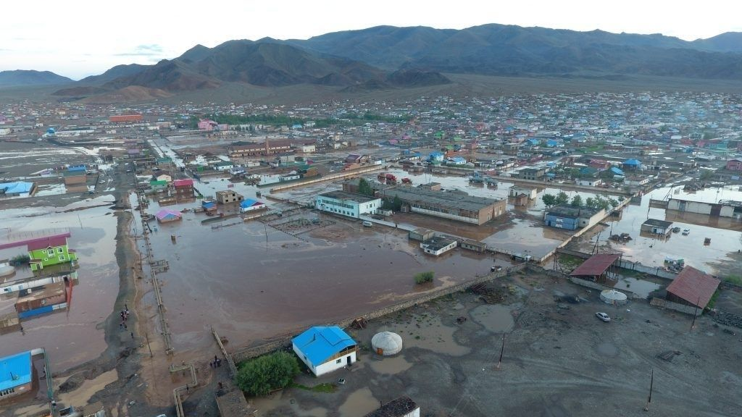
The numbers of flood events in Mongolia 2000-2019
Bayan-Ulgii aimag, 2016
Resource: NEMA, 2018

Slide 11
The linkages of the DRR strategy & Action Plan (Phase 2) with existing national policies and plans on climate change adaptation
  Phase 2: Action Plan of National Medium-term Strategy for the Implementation of Sendai Framework in Mongolia (2021-2025)
Objectives of the DRR Strategy & Action Plan National policies & plans on CCA | Priority 1 |  | Priority 2 |  |  | Priority 3 |  | Priority 4
 | Objectives |  | Objectives |  |  | Objectives |  | Objectives
 | 1 | 2 | 1 | 2 | 3 | 1 | 2 | 1 | 2
Green Development Policy (Mongolian Parliament, 2014, Resolution # 43)
State Policy on Forestry (Mongolian Parliament, 2015, Resolution # 49)
National Action Programme on Climate Change (NAPCC) (Mongolian Parliament, 2011, Resolution # 02)
Mongolia’s Nationally Determined Contribution to the UN Framework Convention on Climate Change (NDC) (Government of Mongolia, 2019, resolution # 407 )
Notes: All objectives of DRR strategy & Action Plan (Phase 2) are directly and contentually linked with the current active national policies and their action plans on CCA

Slide 12
Highlights: Mongolia’s Nationally Determined Contribution to the UN Framework Convention on Climate Change (NDC)
(Government of Mongolia, 2019, resolution # 407 )
The linkages of NDC and DRR strategy & Action Plan
(4.3.6) Goal: Build resilience to natural disasters by reducing the risks and adapting to impacts of climate and weather-related hazards and disasters.
Targets (4.3.6) of Nationally Determined Contribution | Priorities (P) and Objectives (O) of the Med-term DRR Strategy and its Action Plan
Target 1. Conduct and regularly update risk assessments for natural disasters, and reduce the disaster risks based on the partnership of various stakeholders | P1/O2 Implement a methodology for disaster risk assessment and set up a disaster information database. P2/O2 Enhance collaboration and partnership for disaster risk reduction
Target 2. Reduce disaster-related losses and damages by strengthening the capacity of early warning systems for climate, weather-related hazards and disasters, and by enhancing the system for effective and timely dissemination of climate and disaster-related information | P4/O1 Increase disaster preparedness for response, and improve resource capacity P4/O2 Strengthen disaster recovery, rehabilitation and reconstruction activities.
Target 3. Integrate disaster risk reduction measures into development policy planning, introduce techniques and technologies in disaster risk reduction, and increase investment and financing | P2/O1 Strengthen the legal environment for disaster risk reduction P3/O1 Introduce modern, advanced techniques and technologies for disaster risk reduction P3/O2 Increase investment for disaster risk reduction activities

Slide 13
Challenges
Way forward
Inactive Inter-agency coordination
Limited guidance how to integrate DRR and CCA
Poor understanding and experience on the linkages between DRR and CCA to implement planned actions
Limited DRR investment and finance
Not public accessible data information
Promote the activities of National and Local Councils for DRR, and their members
Improve multi-stakeholder and cross-sector collaboration to ensure the inclusive planning and implementation.
Develop training programme on integration of DRR and CCA at multi-level and climate related disaster risk reduction, prepare trainers and conduct trainings
Joint finance for the implementation of DRR and CCA measures
Improve data information access.
Enhance international cooperation

Slide 14


NEMA Mongolia
Thank you for your attention!
Lt.Col Bazarragchaa DUUDGAI (Ms)
Head of Disaster Risk Assessment Division
NEMA, Mongolia
Email: bazarragchaa@nema.gov.mn
bazaraasg1@gmail.com

